Slide 1

BRAIN TUMOR 3D SEGMENTATION
Rajkumar Conjeevaram mohan
DATS 6450: Cloud computing
May 11th, 2023

Slide 2
OBJECTIVE
Segment Abnormal Tissues From The Brain
01
Represent its stature, and form as a 3D object.
02
Help in accurate diagnosis
03

Slide 3
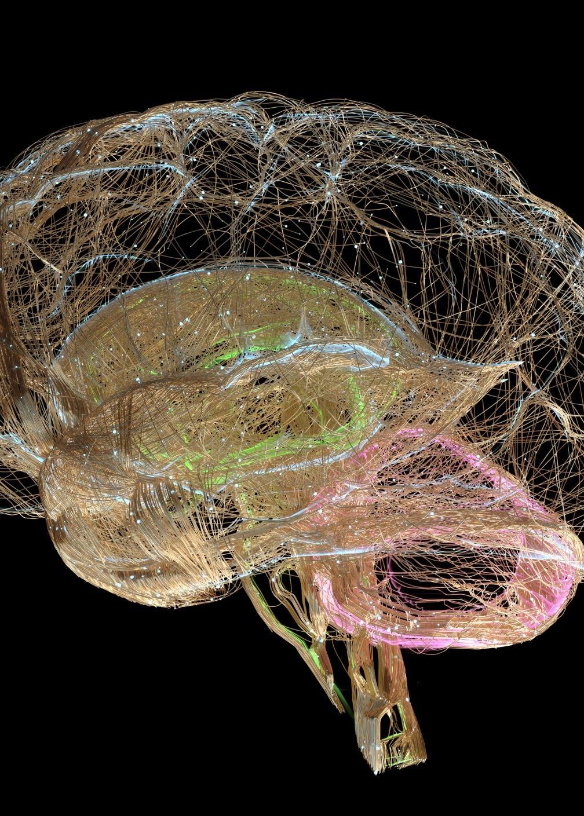
BraTS Dataset | Kaggle
Brain Tumor Segmentation | Kaggle
80GB of MRI Scan Images each of dimension - 240x240x155 (691 Images for training / 988 total)
Each image has 3 different versions – T1, T2, and T1CE
Includes data from 2021, 2020, 2019, and 2018

Slide 4
DATA PREPROCESSING
Crop cubic block from the volumetric image
Crop resolution
120x120x64
PyTorch’s Custom Dataset

Slide 5
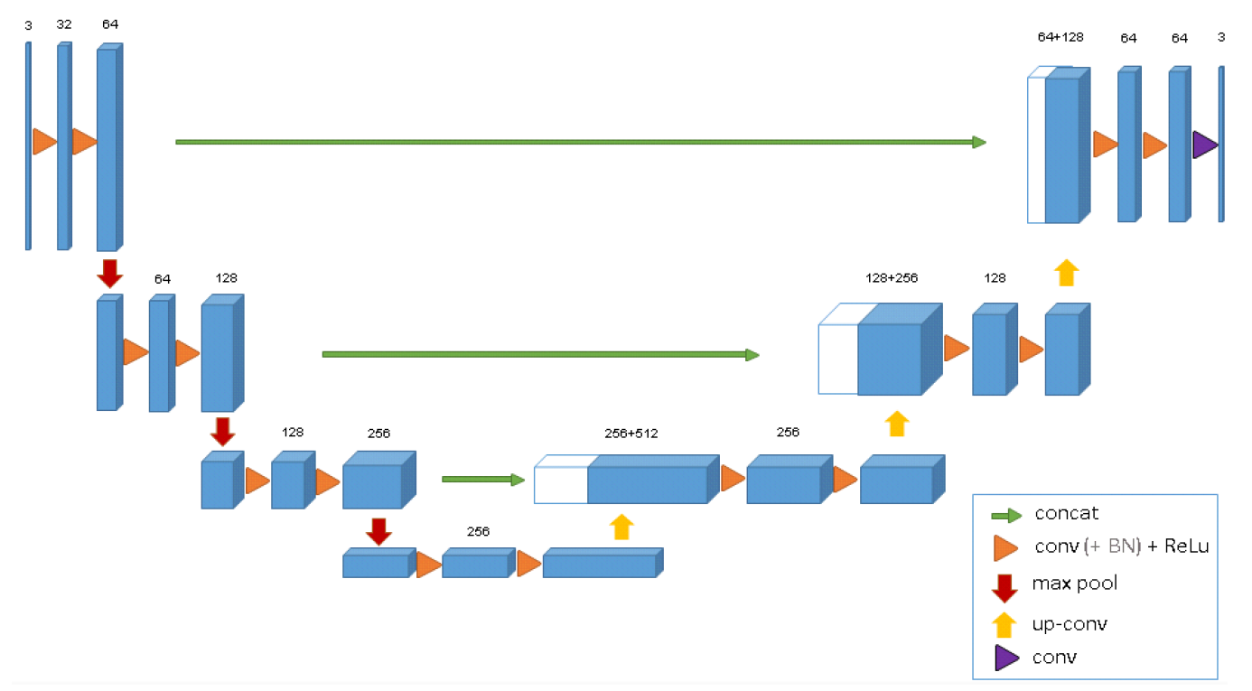
3D U-Net Architecture

Slide 6
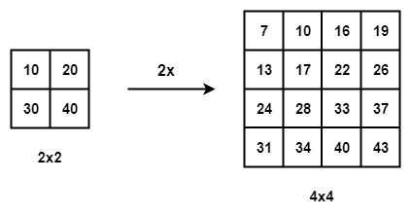
BICUBIC INTERPOLATION
Source: Image Processing – Bicubic Interpolation | TheAILearner

Slide 7
Architectural improvements
1. Residual blocks instead of concatenation
2. Improved interpolation – Bicubic instead of Bilinear
3. Convolution with groups
Practical considerations:
1. Minimized use of high number of true negatives

Slide 8
Optimizations
Learning rate: 1e-3
Batch size: 1
Epochs: 80
Prefetch Factor: 60
N Workers: 20
Jaccard Score: 0.78

Slide 9



AWS Architecture
AWS Virtual Private Cloud (VPC)
Availability Zone
EBS-backed EC2 Instance
Training And Inference

Slide 10
DEMO

Slide 11

THANK YOU !

